Slide 1
Data Collection ——Background——
“Data Mining: Methods and Applications”

Slide 2
Contents
Background
Data Acquisition
Data Labeling
Improvement of Existing Data and Models
How to Decide which Data Collection Techniques to Use When
Interesting Future Research Challenge

Slide 3
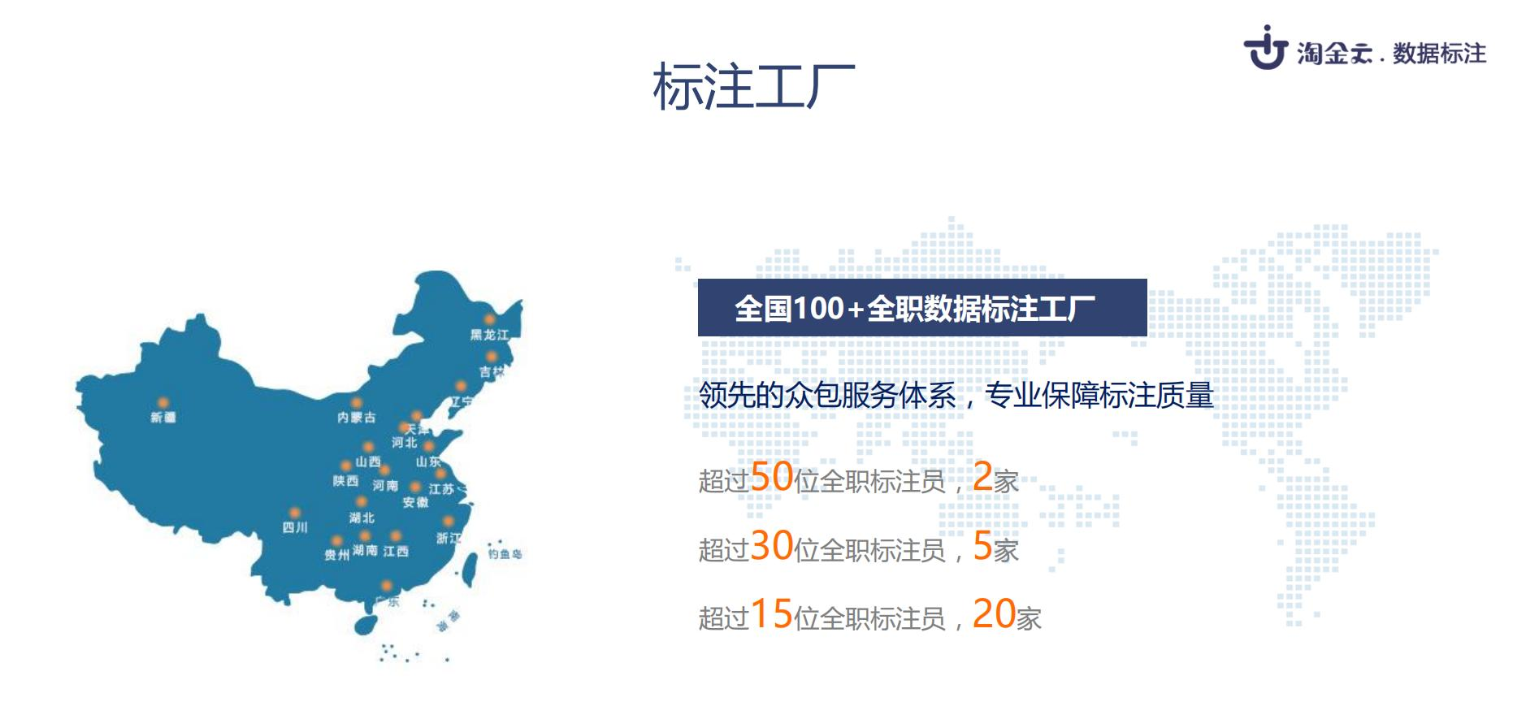
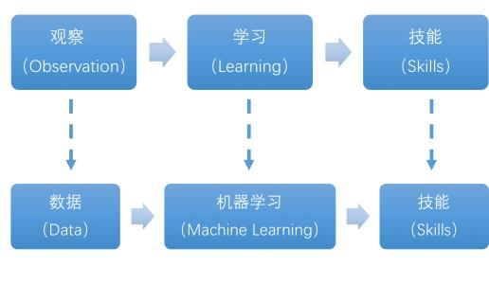
Background
The reasons for data collection
New applications(data mining, machine learning) do not necessarily have enough labeled data.
Traditional Machine Translation and Object Detection: massive amounts of data
New Applications: manual labeling(expensive and domain expertise )
Unlike traditional machine learning, deep learning techniques automatically generate features, which saves feature engineering costs, but in return may require larger amounts of labeled data.

Slide 4
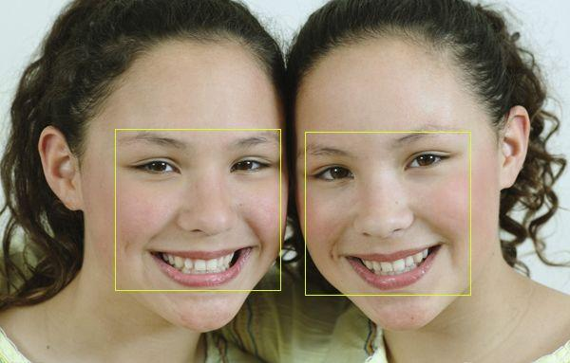
Background
Related Applications
Machine Learning(ML), Natural Language Processing(NLP) and Computer Vision(CV)
End to end (端到端) machine learning applications: collecting, cleaning, analyzing, visualizing, and feature engineering
Data Management

Slide 5
Background
There is a pressing need of accurate and scalable data collection techniques in the era of Big data.
Share and search new datasets: data acquisition techniques can be used to discover, augment, or generate datasets.
Once the datasets are available, various data labeling techniques can be used to label the individual examples.
Instead of labeling new datasets, it may be better to improve existing data or train on top of trained models.

Slide 6
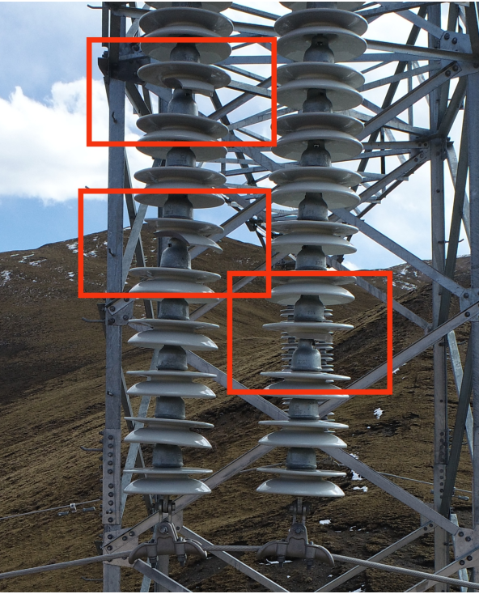
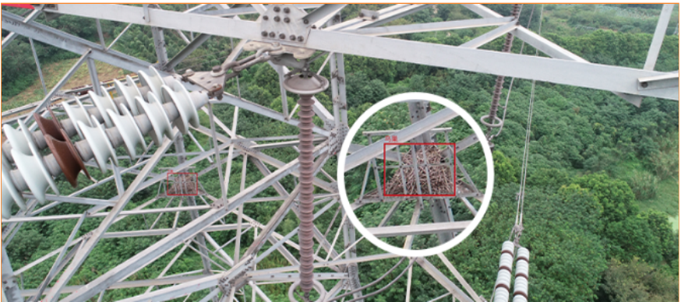
Background
Labeling Data

Slide 7
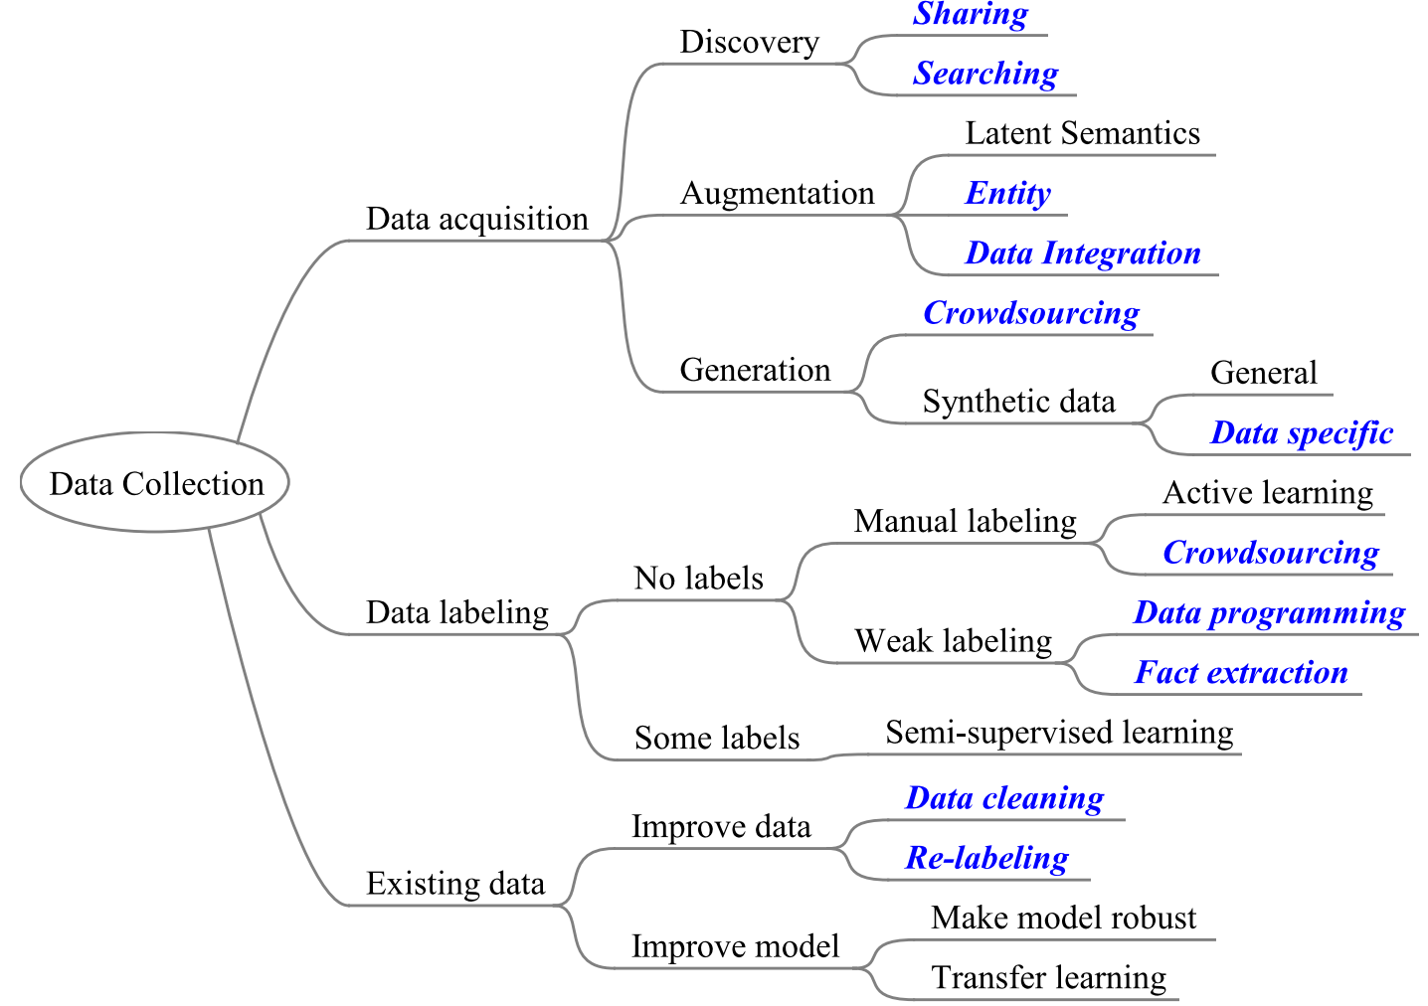
Background
Research Landscape of Data Collection
Research Landscape:
The topics that are at least partially contributed by the data management community are highlighted using blue italic text.

Slide 8
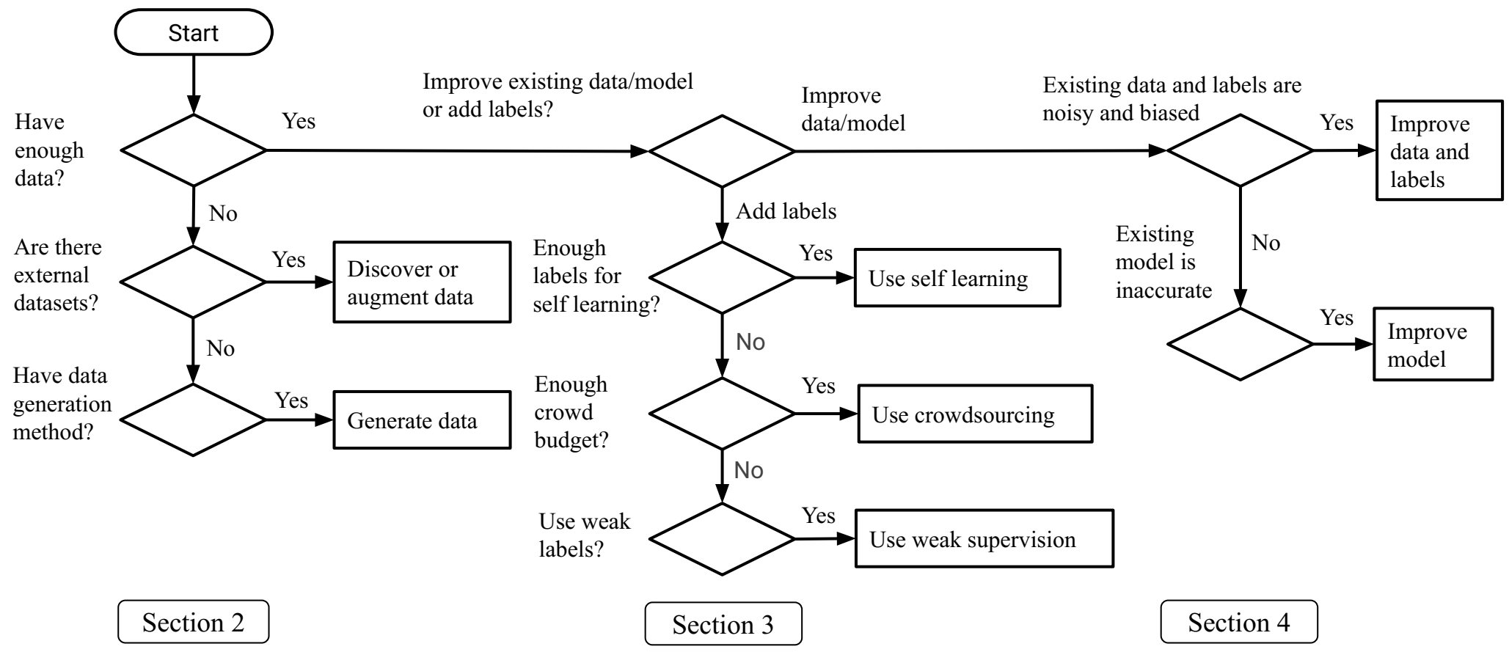
Background
A general decision flow chart of the data collection techniques

Slide 9
Background
Data Acquisition：data discovery, data augmentation and data generation
Data Labeling：utilizing existing labels, using crowdsourcing techniques, and using weak supervision
Improving Existing Data or Models
Method Integration：Put all techniques together

Slide 10
Contents
Background
Data Acquisition
Data Labeling
Improvement of Existing Data and Models
How to Decide which Data Collection Techniques to Use When
Interesting Future Research Challenge

Slide 11
Thanks！
Notes:
工作新意图发现

